Slide 1
Principles and Practice of Blockchains Course Introduction

Slide 2
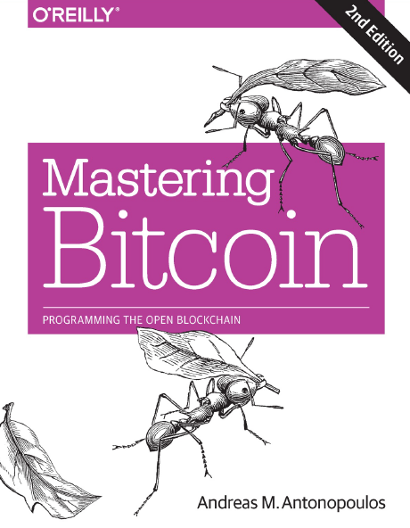
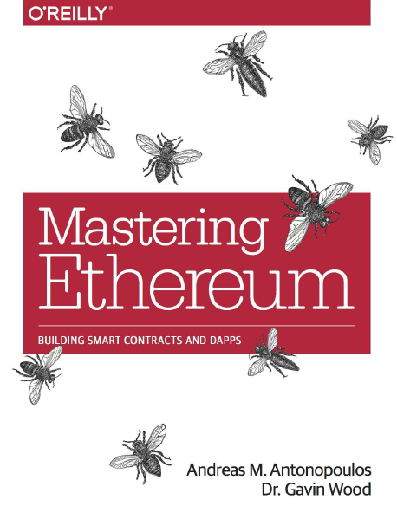
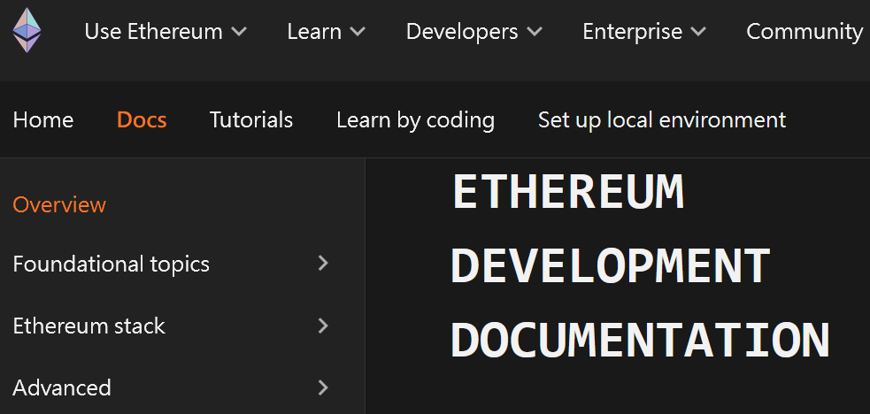
Course Materials
No Textbook. Using lecture slides.
Reference Books & Resources:
Mastering Bitcoin - Programming the Open Blockchain, 2nd Ed., 2017.
Mastering Ethereum - Building Smart Contracts and DApps, 2018.
Ethereum Development Documentation

Slide 3


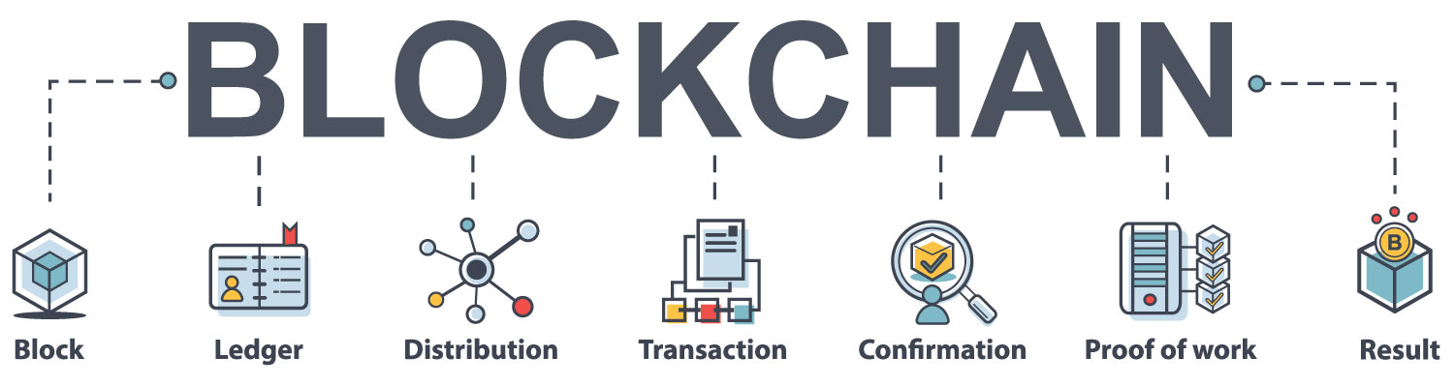
Course Topics (1/2)
Part I: Bitcoin and Blockchain
Bitcoin Testnet
Bitcoin Keys and Addresses
Bitcoin Wallets
Bitcoin Transaction and Scripting
Bitcoin Network
Bitcoin Blockchain
Bitcoin Mining and Consensus

Slide 4



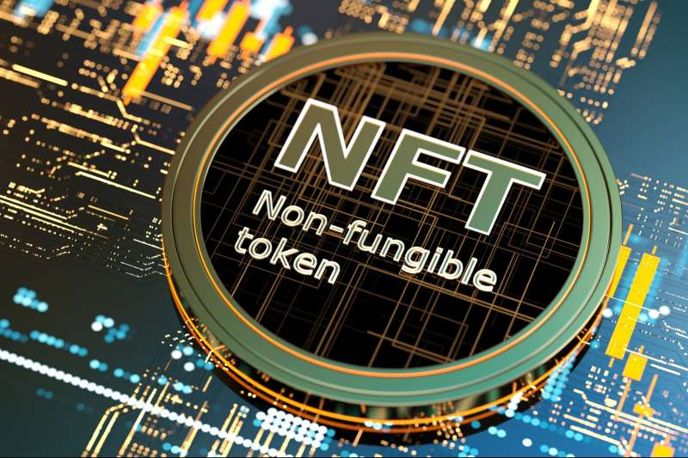


Course Topics (2/2)
Part II: Ethereum
Smart Contracts
Tokens
NFTs
Oracles
DApps
Ethereum 2.0: Proof-of-Stake (PoS), Beacon Chain, Sharding, Off-Chain Scaling

Slide 5




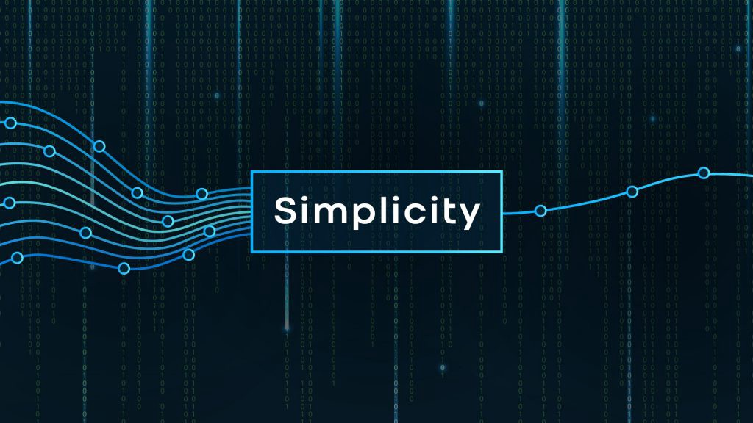

Programming Languages for Blockchain
https://medium.com/nerd-for-tech/programming-languages-used-for-blockchain-development-d212afa1f23b

Slide 6






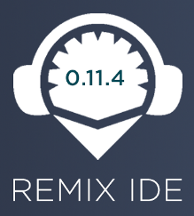







Development Tools for Blockchain
Sepolia Testnet

Slide 7
Grading
Homework: 50%, Term Project: 50%
2~3 members per group for Homework and Term Project
Homework (in Solidity)
Hw-1: Programming a Faucet contract (using Remix)
Hw-2: Programming a better Faucet contract (using Truffle)
Hw-3: Programming an ERC20 Token Contract (using OpenZeppelin)
Hw-4: Programming an ERC721 Token Contract (using OpenZeppelin)
Hw-5: Programming a Smart Contract using Chainlink Oracles
Hw-6-Bonus: Developing Web Interface(s) for Hw-1 ~ Hw-5

Slide 8
Course Plan
Bitcoin
UTXO vs Account Model
Introduction to Bitcoin and Blockchain
Bitcoin Keys, Addresses, and Wallets
Bitcoin Transaction
Bitcoin Network and Blockchain
Bitcoin Mining and Consensus
Term Project Presentation
Team Up
Introduction to Ethereum
Smart Contracts
Tokens and NFTs
Oracles
DApps
ETH 2.0
Hw-5
Market Cap and # Blockchain Nodes or Validators
Hw-1
Hw-2
Hw-3&4
Ethereum

